Slide 1
Grid and Market Modelling (BEIS Study)
EPSRC Grid Scale Energy Storage

Slide 2
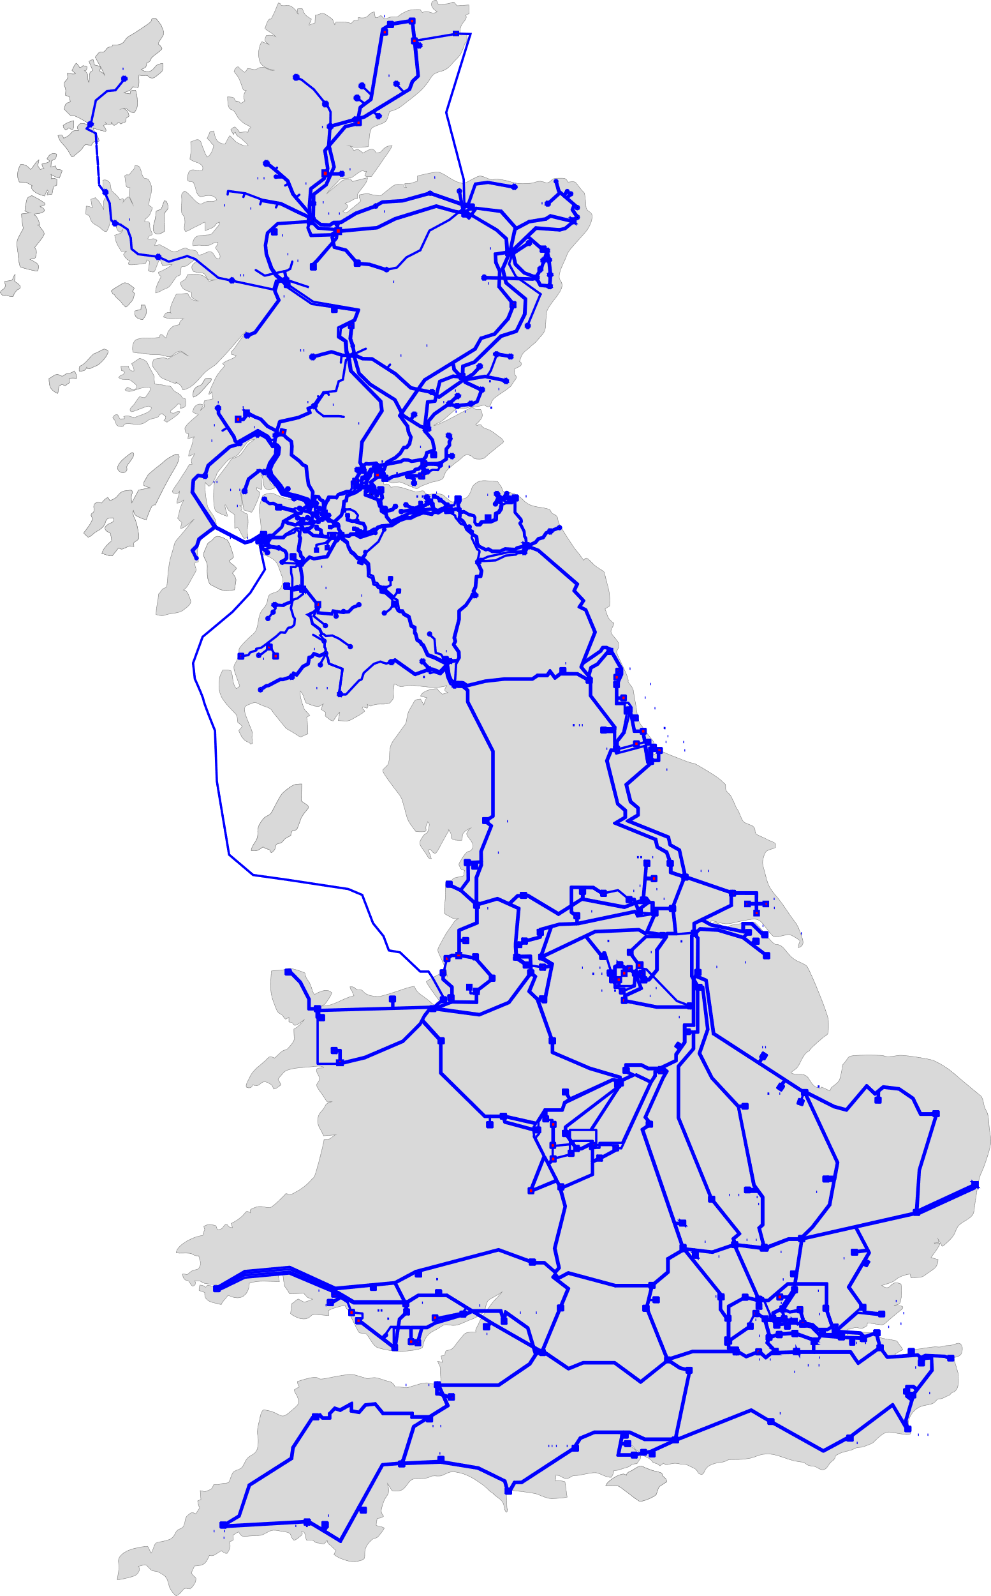
The GB Transmission Network
Built starting from the National Grid Electricity Ten-Year Statement 2021, and adding the lines planned in 2022
Some information:
2934 lines from 400 kV to 33 kV
38 extra lines
2020 nodes

Slide 3
Generators and Consumers
Gen. and Dem.
+50 MW in England and Wales
+30 MW in South Scotland
+10 MW in North Scotland
Submit the expected generation and demand for each 30 minutes settlement period to ESO with a time resolution of one minute
Elexon, 2020a. Balancing and Settlement Code. https://www.elexon.co.uk/bsc-and-codes/balancing-settlement-code/.

Slide 4
FPNs
Expected Demand Imbalance
Expected Generation Imbalance
NG ESO
offer and bid orders to increase and decrease power injections, respectively
Power Injections at Each Node
Solve:
Transmission Line Constraint Violation and Offset Energy Imbalance

Slide 5
Bid and Offer Orders
up to five bid orders and five offer orders
Unit
Settlement Period
Subsidy
(renewables obligation certificates or a strike price in a CfD)
/MWh
Wind and Solar Power Plants
(Marginal Costs≈0)
compensation for curtailed power
(negative) bid price equal to the value of the lost subsidy

Slide 6
Balancing Mechanism Model
Modelling of the BM rebalancing costs
Minimization (Offer Cost - Bid Cost)
Offer Cost = the system operator has to pay to the unit 𝑘 to increase its power
Bid Cost = the unit 𝑘 has to pay to the system operator to reduce the power
Constraints: - power output of the unit 𝑘
- power balance at node 𝑛 and time 𝑡
- power flow over the lines
- minimum and maximum flows for transmission lines
- minimum and maximum capacity limits of each unit
- upper bounds for each offer and bid order

Slide 7
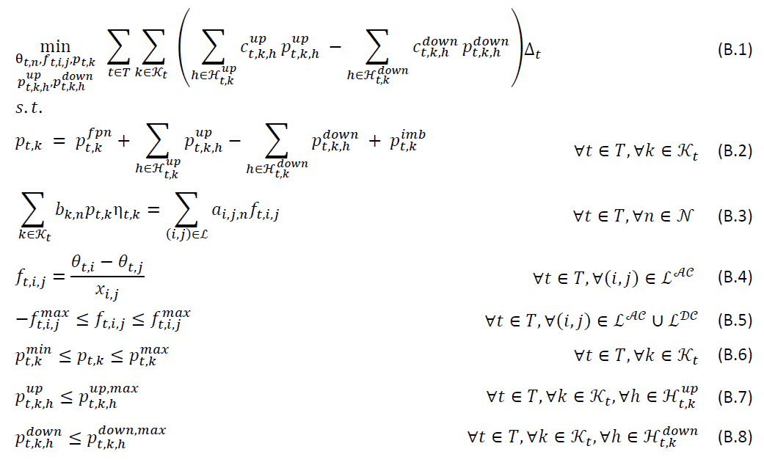
Mathematical Description

Slide 8
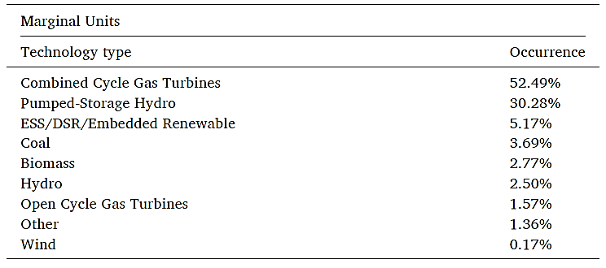
Type of technology and percentage of identified marginal units
August 2020 and January 2021

Slide 9
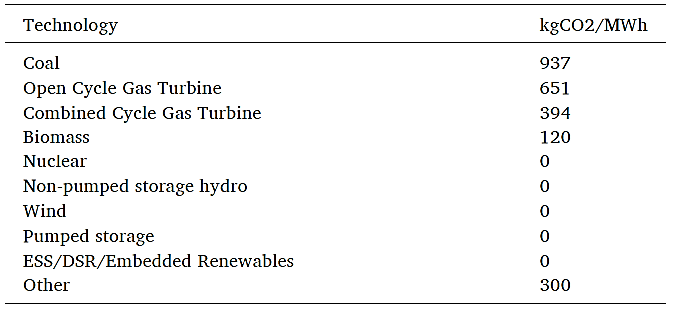
Carbon emission intensity of different technologies

Slide 10
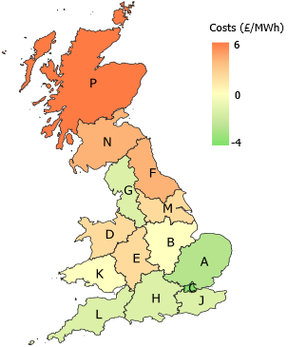
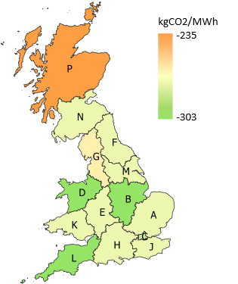
Case study: +1 MW renewable generation in different regions in GB -1 MW from marginal units
Additional BM costs for managing congestions
Total carbon abatement
Savelli, I., Hardy, J., Hepburn, C., & Morstyn, T. (2022). Putting wind and solar in their place: Internalising congestion and other system-wide costs with enhanced contracts for difference in Great Britain. Energy Economics, 113, 106218.

Slide 11
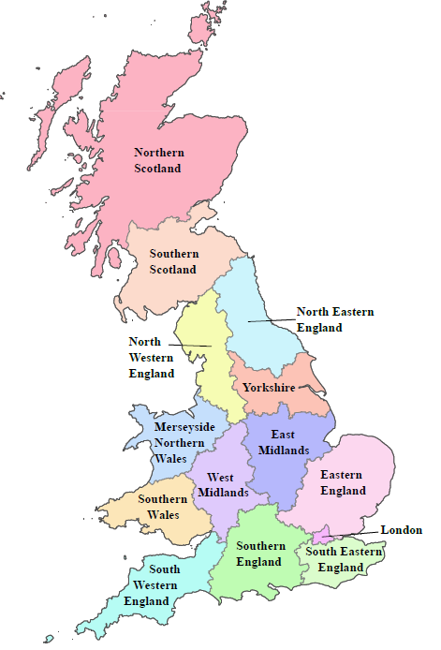
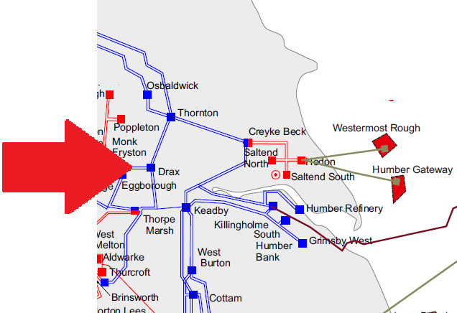
Challenges with embedded units (1)
For directly connected units (generators and large loads) we have the exact connection point.
E.g.
For demand and embedded generation, we only have the DNO area
E.g.
Name | ETYS Node
Drax | DRAX41

Slide 12
Challenges with embedded units (2)
Future Energy Scenario (National Grid)
Our approach:
% Demand in each GSP
Demand in each Grid Supply Point (GSP)
Embedded unit data:
Scheduled dem./gen.
Loss factor
Up/Down bids
DNO area
Total demand in each DNO area
A better solution?

Slide 13
Future Extension Work
Assessment of congestion cost during the rebalancing action
?
Σ
Evaluate the carbon emission during the rebalancing action
Some energy storage capacities (could be in different technologies)

Slide 14
Thank You for Your Attention
Any Question?

